Slide 1
CAE Data
Reduce, Visualize and Share
Prasad Mandava
Notes:
Good Morning and Good Afternoon, I am Dave Nacy and will be your presenter today. Welcome to our Webinar.
This 1-hr webinar will introduce you to how one can efficiently reduce, visualize and share CAE results.
We also cover, how enterprises can use our technologies to communicate CAE results across the Enterprise.
Joining me is Mr. Prasad Mandava, the founder and CEO of Visual Collaboration Technologies.
Here’s the agenda for today’s webinar (next page)

Slide 2
Agenda
Company Overview
Our Focus
Technology Overview
Demo
Preview of new Features of VCollab 2010
Integration with SLM
Summary
Notes:
First, we will give a brief company history and provide some background of developing this technology.
Next, we will then spend a few minutes covering the features and benefits of our Vcollab software. All these will take about 15 minutes.
Then Prasad will conduct a demonstration for about 20 minutes, followed by 10-15 minutes reserved for questions and answers.
In order to conduct this webinar in smooth pace, we ask you to hold your questions till the very end.
Alternatively, you may type your questions anytime on the chat board and we’ll respond to them in the Q&A session.
Let’s get started with a brief story of Vcollab the company and why we were driven to this technology for you.
(Next)

Slide 3
Company Overview
Privately held, Visual Collaboration Technologies Inc. (VCTI) is a software solutions company and is established by a small group of CAx visualization veterans.
Headquartered in Troy, Michigan
Established VCollab Europe jointly with Exemplar in Italy
Customers includes Alenia Aeronautica, Brembo, GM, Honeywell, Pratt & Whitney, Toyota, Textron, etc.
Notes:
VCollab is a privately held software firm established in 2001.
We are currently headquartered in Troy Michigan.
VCollab is a stable company that has mature collaborative visualization technology which has been accepted by several major companies.
This webinar will help explain what the VCollab software system is and why many are choosing to implement it. (Next)

Slide 4
CAE data : Challenges
Styling
Alias
Maya
3D Studio
CAD
UniGraphics
CATIA
Pro/E
Solidworks
Ideas
CAD Viz/Mark Up
VisMockUp
ProductView
3D XML
Etc.
FEA
NASTRAN
ANSYS
MARC
ABAQUS
LS DYNA
…
PRE/POST
HM
SOFY
Animator
ANSA
Patran
…
CFD
FLUENT
STARCD
…
PRE/POST
EnSight
ANSA
TecPLOT
…
Static Geometry
Analysis / Simulations
1) Communication Nightmare! Many apps/formats
2) CAE results file sizes are large! ( HPC )
Notes:
So what is it that we address?
We all have lived thru the rapid growth of CAD/CAM/CAE/CFD in the past 20 years. It is obvious to us that the FEA / CFD market is a very complex space. For every solution, it has its own specific input and out put format. And it requires specific pre/post processing software to go with it. To view the results in any level of details, specific tools are required.
Historically, in order to share our models or results, we needed to send recipients the full deck or raw data. Then person we sent it to needed the same pre/post processing tools to view it or process it.
Wouldn’t it be nice that we have something similar to pdf that we can use to easily communicate with others using just a viewer?
Such solutions have existed for a long time in the CAD world, as part of product lifecycle management systems. Unfortunately, there is not such tool for the CAE user community that makes it easy to publish your models and results so that they can be: shared via a web browser, shared as a Microsoft Office document like PowerPoint and Word, or integrated with our simulation data management system.
Establishing something like pdf for CAE is the driving force for us to develop VCollab technology, now a de facto standard for CAE visualization in many companies.
The concept is simple, but try to realize it is another matter. To be successful we’ve had to address a number of challenges.
First, there are many different solvers with different output formats in CAE. So, a means to convert models and results from a myriad of solvers is needed.
Secondly, the CAE file sizes are large. The amount of data needs to be reduced so it can effectively be managed and shared.
The information is so diverse from scalar, vector to Tensors, eigen vectors to transient simulations. Many visualization types are needed so that results can be presented in a form that enable people to understand and explore your models and the results of your analyses.
We have to deal with 3D visualization and effects. Computer graphics have undergone tremendous change over the years and we want to offer you state-of-the art graphics presentation and interactivity.
So, in the last few years we have spent a tremendous amount of effort implementing interface technologies to commercial CAE/CFD software, creating compelling 3D visualizations, supporting diverse post-processing requirements, and integrating with popular data management systems while making sure our tools are easy-to-use, especially for the non-CAE user.
What we do is enable you to efficiently and effectively communicate your results from CAE/CFD solvers in a lightweight, portable format, with powerful visual effects.
As you will see in today’s presentation we can help you to reduce your large data sets into portable, shareable files and allow people to display and interact with your 3D models and results using VCollab’s lightweight visualization tools.
(next)

Slide 5

CAX - Common 3D Data Model for 3D CAD/CAE Data
Styling
Alias
Maya
3D Studio
CAD
UniGraphics
CATIA
Pro/E
Solidworks
Ideas
Mark Up
VisMockUp
ProductView
3D XML
Etc.
FEA
NASTRAN
ANSYS
MARC
ABAQUS
LS DYNA
PRE/POST
HM
CFD
FLUENT
STARCD
…
PRE/POST
EnSight
Geometry
Mesh + Simulation Results
CAX = Common, Unified, Ultra Compact 3D Data Format
Notes:
As a first step, we developed an ultra compact, vendor neutral, common data format called “.CAX”, to store any 3D FEA/CFD data efficiently. <click>
The CAX file can also be used to visualize CAD. CAD support isn’t as extensive as the designer centric JT format. CAX support for CAD is done in a way to meet the needs of the CAE community.
VCollab’s CAX format is Similar to Adobe’s portable document format, otherwise know as PDF. Think of CAX as the “PDF of CAE Data”. The CAX files are ultra compact and are easily portable.
The CAX file definition is a key element that we’ve invested our resources developing and refining over the years. It is the result of what we’ve learned from interactions with our customers and we continue to listen and respond to market needs.

Slide 6
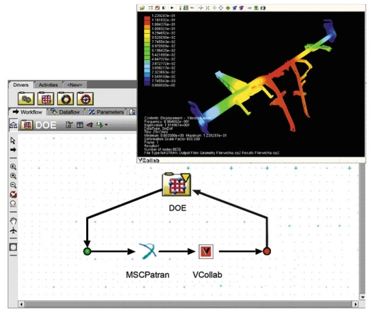
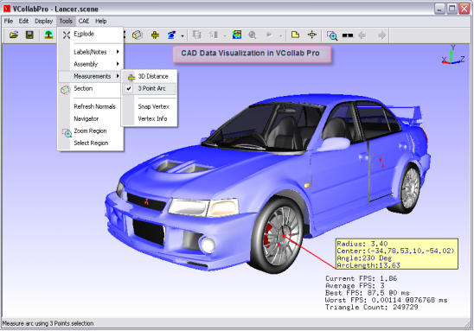
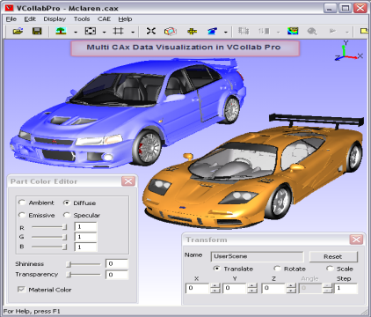
Our Solution
CAX - A vendor neutral, common data format to store and visualize 3D CAE/CFD data with extension to CAD – in an ultra compact form. Stores meta data with models.
Data retrieval and data reduction technologies
High performance Viewers
Integration with process and data management systems, and job submission systems
Notes:
Then, we have developed other essential tools around CAX. First are the tools for CAE data reduction. We overcame the most challenging part of the interface technology to 3rd party codes. We discuss more about them as we go.
Viewers were developed to view the CAX files, with state of the art graphics and high performance, from a simple Viewer to full VR environment. We will see the demo of these viewers at the end.
CAX files can be easily integrated with existing process and data management systems in an enterprise.

Slide 7
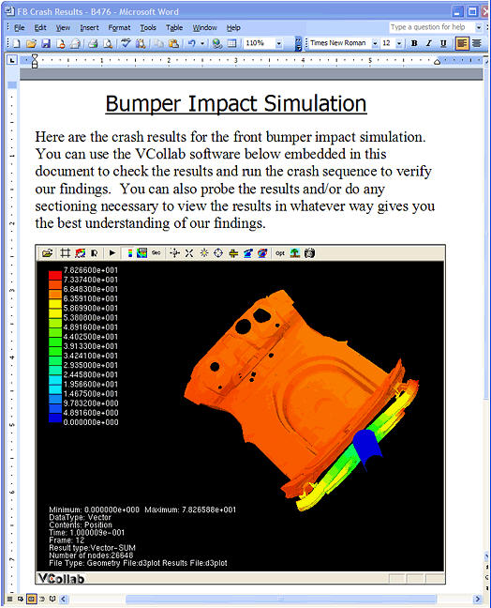
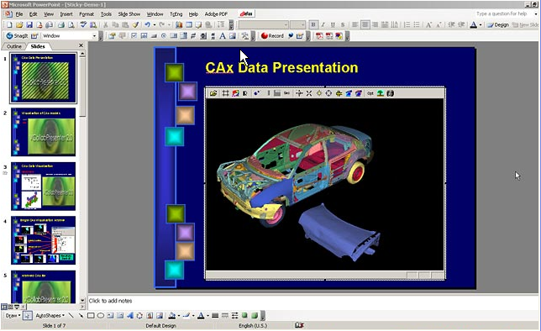

How users benefit from CAX file?
  CAX files enable enterprises to maximize the utilization of CAE data and CAE investments.
  Analysts can quickly visualize simulation results without moving the large native CAE data files
  Share 3D simulation results with others
  Non CAE experts can view and understand CAE results without needing the native pre/post software
  Embed 3D CAE results in MS Office documents or WEB
  Effective Presentations/Analysis Reviews in 3D
  Store or archive CAE results with meta data
3D .DOC
Notes:
Let us see how you and your company can benefit from CAX files.
Because CAX files are compact, they are easily portable. CAX makes CAE data portable. That is significant. This portability allows companies to maximize the utilization of CAE data and CAE tools.
Users can use CAX files to visualize CAE results without moving large native CAE data files.
Non-CAE experts like designers can view and understand CAE results without requiring native post processor licensing and installation.
Share CAX files easily with colleagues, managers, designers, suppliers and other relevant players.
Users can use CAX files for analysis reviews.
CAX files can be embedded into MS Office documents and WEB, opening up whole gambit of possibilities for maximizing the utilization of CAX data.
Automatic engineering reports can be generated, leading to improvement in productivity of analyst.
CAX files can be easily stored and archived for long term use.
(Reduce. Share. Visualize.)

Slide 8
VCollab Solution: Reduce , Visualize, Share CAE Data
.
Durability
NVH
Crash
Safety
CFD
Thermal
Static
Static
Simulation
Simulation
Simulation
VMoveCAE .. Universal Data Reduction Engine / Translator
Highly Reduced Visualization Format *.CAX
VCollab
Presenter Lite*
VCollab
Presenter
VCollab
Pro
* Free Viewer
3D Documents
Interactive 3D .ppt
Interactive 3D .doc
Web
High Performance
Visualization &
Authoring tool
Notes:
Here is how the Vcollab solution fits into the CAE ecosystem. Data from different simulation domains can be converted into one common CAX format.
As you see, CAX is the center of the solution architecture. VMoveCAE is the translator that generates CAX from many popular CAE software.
There are three options to select from that enable you to visualize CAX files.
VCollab Presenter Lite is the freely downloadable viewer for the desktop. Vcollab Presenter Lite is like the Adobe Acrobat Reader. It’s a free download, so anyone can get what they need to view your CAX files. Once installed, all users have to do is double click on a CAX file and it opens in VCollab Presenter Lite. It’s that simple.
Vcollab Presenter can also be purchased to add additional post-processing features for decision support such as data probing, changing legend scales, finding hot spots, vector plotting, and integration with Microsoft Office tools. It’s easy to use, easy to deploy by IT and would be an essential tool for everyone to view and understand the CAE data.
VCollab Pro is the tool created for content authors like analysts. Using Vcollab Pro, one can edit and create specific views or 3D slides of the model that they like to share/present. Vcollab Pro is the authoring tool you can use to put the content you want to publish in the form you want people to see.

Slide 9
CAD vs CAE translations
CAD
CAE
VRML
Translator
VRML2CAX
Translator - VMoveCAE
Highly Reduced CAE Results .. CAX files
VCollab Presenter
VCollab Professional
3D Documents, Interactive PPT, WORD, EXCEL Documents
Scalable High Performance CAX Viewer

Slide 10
Integration with MS-Office & Web
(Report & Archiving)
CAD/CAM/CAE Tools
CATIA, UG, PRO/E, IDEAS, ABAQUS, NASTRAN, ANSYS, LS-DYNA, Fluent, EnSight, etc.
Interactive 3D
JPEG
MPEG/AVI
CAX
PowerPoint, Word, Excel, WEB Page
Interactive 3D Engineering Documents
Value : Ease of Use, Decision Support to SDM
Notes:
Let us talk little bit more on the CAX and MS office integration and see what it offers to CAE community.
As the diagram shows, 2 different worlds exist in our work environment. One is a very complex CAE domain where only experts can effectively use complex and expensive software tools. The other world is the easy-to-use MS Office world. Everyone knows how to use popular Office tools like Excel, Word, and PowerPoint. VCollab bridges these 2 worlds with CAX and VCollab Viewer. With this capability, CAE community can build interactive 3D Engineering Reports that everyone can use.
It is common practice in CAE community to create a number of images, videos and use them as lightweight vehicles for CAE communications.
CAE CAX files enhance these CAE communications with interactive 3D. CAX files have similar integrations with MS Office documents or WEB. One can take CAX file and embed into PowerPoint slide as easily as one embeds an image or video. We will show a demo of this in a bit.

Slide 11
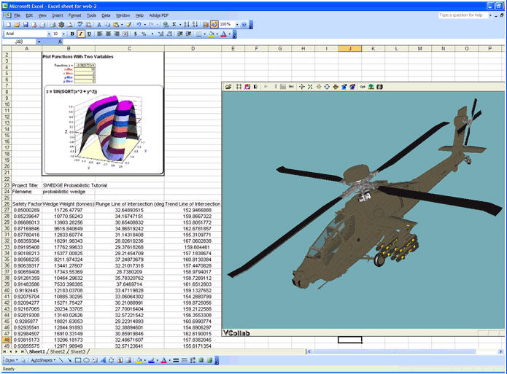



Interactive 3D Presentation / Documentation
with MS-Office
3D PPT
3D DOC
3D XLS
Notes:
I am sure, most of you heard about 3D PDF. With VCollab, you can make 3D PPT, 3D DOC, 3D XLS documents.

Slide 12
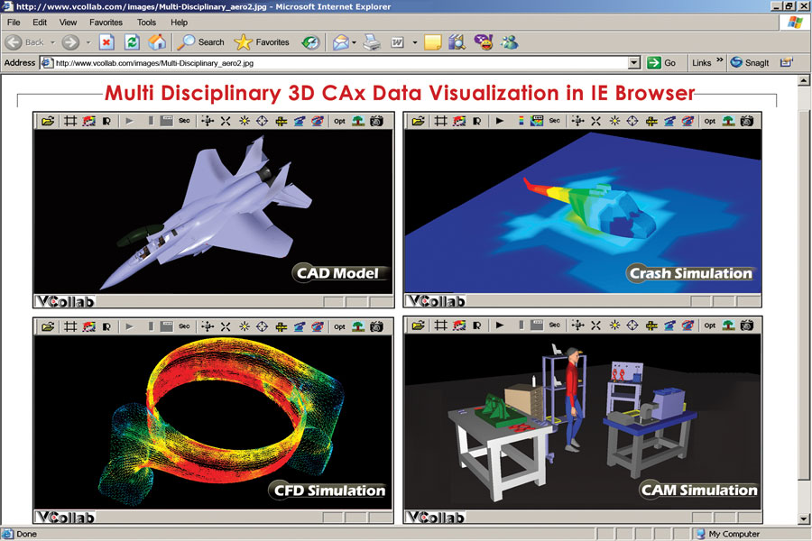

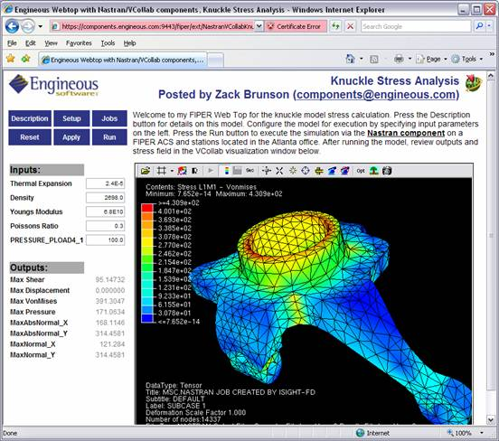

Integration with Web
Integration with
Simulation Process Management
Web Integration
Notes:
Similarly, CAX files can be integrated into WEB pages.
Significant point to note is that the CAX files and VCollab Viewer are integrated with many CAE process management systems as well as Simulation Data Management systems.

Slide 13
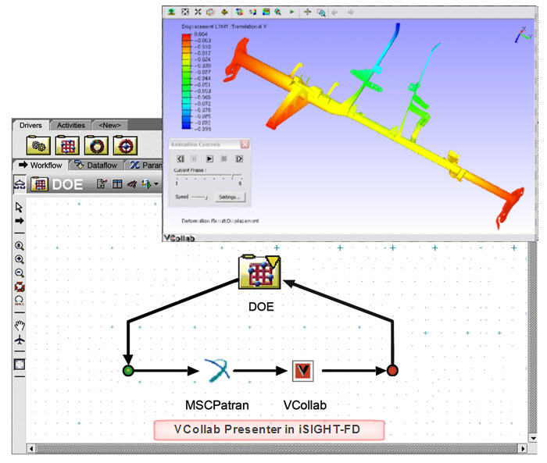
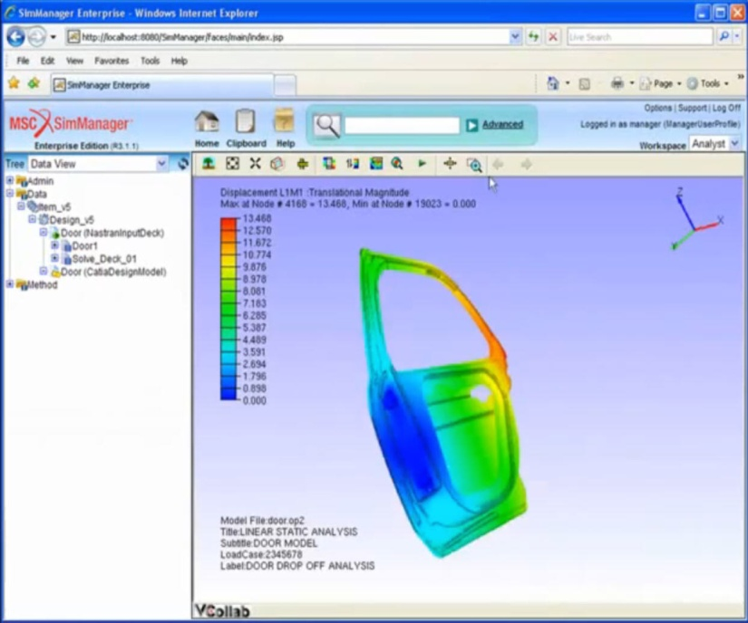
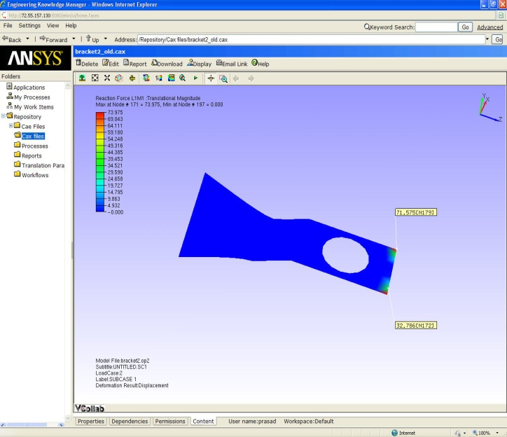
Integration with Data Management Systems
  MSC/SimManager
  Simulia/SLM
  Ansys/EKM
  MS SharePoint
  Integrates easily with other PLM / SLM systems

Slide 14
New features in VCollab 2010
Enhanced CAX Writer API
XY Plotting capability
Automatic Presentation generation capability
Automatic report generation capability
Animator capability
Meta Data Extraction capability
Meta Data Creation capability
Enhanced integration with MS Office, MDO tools and SLM/PLM tools
Viewer functionality in batch mode
Remote Visualization
Visual CAE Data Portal

Slide 15
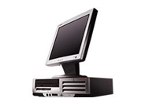

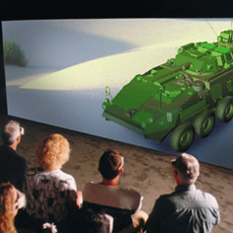
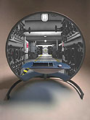
Enhanced Display Options with VCollab Pro
CAE
CAD Data
UniGraphics
Product Vision
Structural
NASTRAN
ABAQUS
FATIQUE
FATIGUE
CFD
StarCD
Fluent
  VCB Files
VCollab Pro
Option 1
Option 2
Option 3
Option 4
Visualize and Analyze the 3D CAE data on DeskTops/LapTops
Visualize and Analyze the 3D CAE Data in Stereo on DeskTops/LapTops
Large Flat Screen Design Review Centers in Stereo
Inspect the interiors of the parts and assemblies in Vision Dome

Slide 16
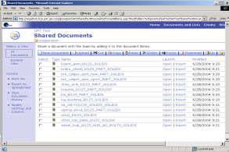

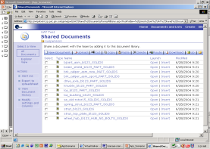
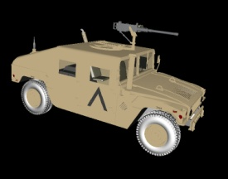
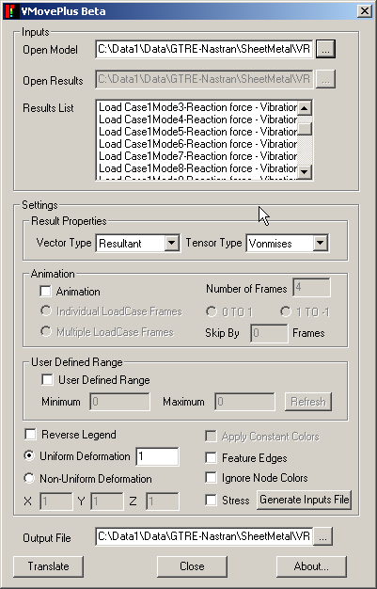
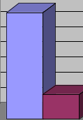




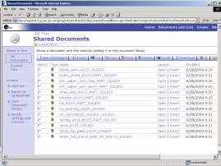
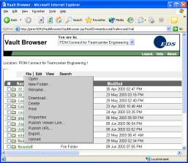

Enterprise Deployment scenario
Suppliers
CAE/CFD
Engineer
VCOLLAB
PRESENTER
SLM
LICENSE SERVER
VMOVECAE
SLM
CAX
CAE Engineer
Location 1
Data
Extract
Compress
WEB SERVICE
SLM
VCOLLAB
PRESENTER
LICENSE SERVER
ABAQUS
https
CAE/CFD
Engineer
NASTRAN/DYNA
SLM
FILE
SERVER
HQ
CFD Engineer
Location 2
StarCD/FLUENT
NFS
VCOLLAB
PRESENTER
Benefits
Light weight CAE data sharing strategy with dramatic file size reductions
Improved collaboration with easy to use CAx viewer
DISK
STORAGE
SLM
DRE/DE
Location 3

Slide 17
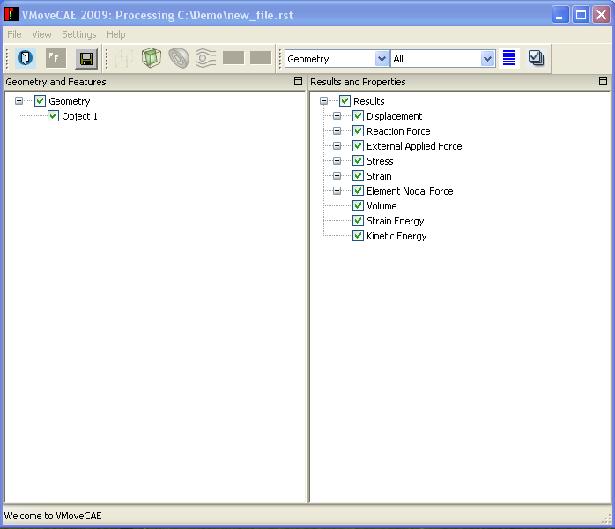
VMoveCAE : Universal Data Reduction Engine
VMoveCAE: Tool to reduce CAE data and generate compact CAX files.
  GUI
  Batch command
  Remote execution on HPC (ex. Scripts )
  Attributes based filters
  Filter results
  Filter Load Cases
  Filter parts
  Volume feature extractions
XML files for customizing reduction criteria
GUI mode
Batch Mode
Notes:
VMoveCAE is a key tool that works like a universal CAE data reduction engine. It reads native CAE data and converts the CAE models and results into compact CAX files.
VMoveCAE can be run interactively or in batch mode.
The batch capability allows enterprises to reduce the CAE results files on HPC/storage server into smaller CAX files as part of a job run. Then, the CAX files can be made available to global teams, suppliers for CAE visualization and collaboration.
Results, time steps/load cases, parts etc. can be filtered to only include the result types of interest. VMoveCAE uses XML templates for customizing the reduction criteria so that one can maximally compress the data. Departments or enterprises can capture their best practices, define them in XML files, and apply them to create CAX files that contain all of the model and results data of interest.

Slide 18
VCollab supported CAE Applications & Formats
Natively Supported CAE Software | Formats Supported | Remarks
MSC.NASTRAN, NX.NASTRAN | OP2, BDF | Supports Complex Eigen Vectors
ABAQUS | ODB, FIL, INP | Supports V6.9
MSC.MARC | T16 and t17 plot files
ANSYS | RST, RTH, RFL
LS-DYNA | D3PLOT files, key Files
FLUENT | Binary Output (.CAS and .DAT files)
PRO MECHANICA Design Study Files | .NEU
IDEAS | .UNV
ENSIGHT GOLD | .CASE, .ENCASE
PATRAN | .PAT, .OUT files
Star-CD (Star-CCM) | .CCM
Notes:
Here are the CAE applications and the formats, that are currently supported by VCollab.
We continue to support more and more tools every year.

Slide 19
CAX .. Sample File Size Reductions
CAE Software | CAE Results File Size ( MB) | CAX File Size (MB) | File size reduction | Time for translation
MSC NASTRAN | 289 | 46.4 | 84% | <1 Min
MSC MARC | 243 | 23.9 | 90% | >1 Min
ANSYS | 14000 | 92 | 99% | ~ 1 Hr
LS DYNA | 15 | 4.45 | 68% | <1 Min
ABAQUS (ODB) | 628 | 48 | 92% | 2 Mins
FLUENT | 347 | 13.1 | 96% | < 1 Min
Notes:
The file size reductions vary based on a variety of factors. The % vary around 50 to 99%. The key is that VCollab provides tools to the users to set the reduction criteria and control these file size reductions.
Note: Need to filter and then compress to get maximum savings. Compression alone is not enough.

Slide 20
CAX .. reduce further by filtering
CAE Software | CAE Results File Size ( MB) | CAX File Size (MB) | File size reduction | Time for translation
NASTRAN ( 7 results) | 289 | 46.4 | 84% | < 1 Min
NASTRAN ( One result extracted) | 289 | 11.6 | 96% | < 1 Min
Notes:
The file size reductions vary based on a variety of factors. The % vary around 50 to 99%. The key is that VCollab provides tools to the users to set the reduction criteria and control these file size reductions.
Note: Need to filter and then compress to get maximum savings. Compression alone is not enough.

Slide 21

VCollab within with Data Management Systems
VMoveCAE in batch mode
  XML Session files for data mining
  Meta Data Extractor
VCollab Presenter Viewer

Slide 22
Share CAX
Thru e-mail
Thru PowerPoint or Word or Excel
Thru WEB Page
Thru SharePoint or other portals
Thru PLM
Thru SLM
Thru ERP

Slide 23
VCollab Product Configuration
Product | Description | License Model
VMoveCAE | CAE Data Translator Works in Batch Mode as well as GUI Mode. Generates light weight CAX files from CAE results files. | - FlexLM - Floating- LAN - Floating- WAN
VCollab Presenter | Light Weight CAE viewer To view VCollab CAX files. Extends visualization to decision support. Works within MS Office, MS SharePoint and Web Browser integration. | - FlexLM - Node Lock - Named User
VCollab Professional | Thick Client / DMU type tool for CAX Multiple model overlays, Parts and Results filtering, Annotations, Viewpoints, Walkthrus, AVI/GIF Animations, Stereo Views can be created. | -FlexLM -Floating-LAN -Floating-WAN
VCollab Presenter Lite | Light Weight CAE viewer (w/ Limited Functionality) | Free
CAX Writer API | Provides ability to write CAX files from 3rd party CAE solvers, Post Processors, in-house CAE applications. | TBD
Tools for Analyst
Tools for Designer
Notes:
VCOllab Presenter Lite ( free Viewer) and the CAX writer API are new products. Both are very significant for success of the CAE PDF startegy.
Presenter Lite allows enterprises to integrate designers, release engineers, service personal, partners and suppliers into the CAE data sharing and collaboration process.
CAX Writer API would allow the customers with in-house CAE software and the CAE vendors to write out the CAE results into ultra compact and portable CAX files.

Slide 24
VCollab Overview
VCollab?
  VCollab is a technology developed solely for better communication of 3D simulation results..
  VCollab’s CAX format is similar to PDF for MS-Office Documents.
  (PDF of CAE Data)
VCollab Benefits
  Extends CAE/CAD data access to Designers, Test Engineers, and Chief Engineers. Non CAE experts can now view and understand CAE results.
  Analysts can exactly control how much information to share.
  Facilitates productive Analysis Reviews
  Provides Unified and Consistent Platform for CAE/CAD data access
  Offers CAE data Communication backbone to CAE teams
Notes:
Let us look at the benefits.
VCollab provides CAE communications backbone thru ultra compact CAX.
Facilitates productive Analysis reviews and collaboration among CAE team.

Slide 25
Summary
CAE Data Reduction
Unified Visualization
Light Weight Data Sharing and Collaboration

Slide 26
Value proposition to SDM/SLM/PLM customers
Available
  Large file handling. No need to move large CAE results files for visualization.
  Easy to use and light weight visualization capability with enhanced CAE decision support for SDM/PLM users
  Integration of Non CAE Experts in SDM/PLM process with 3D CAE Viewing capability
  Meta data extraction from many CAE software into XML format. Ex. Helps in creation and integration of meta data from many CAE solvers into PLM/SLM.
  Automatic report generation capability. Ex. Consistent CAE reports from PLM/SLM solutions
  Batch post processing

Slide 27
Value proposition to iSightFD customers
Available
  Large file handling. No need to move large CAE results files for visualization.
  Easy to use and light weight visualization capability, enhanced CAE decision support for SLM users
  VCollab + Webtop integration
  Meta data extraction from many CAE software
  Visualization features in batch mode for automation
    Create Viewpoints in batch mode. Create a template and re-use
Work in progress
  Parameter extraction mechanism
  VCollab + V6 integration.
  Automatic report generation capability

Slide 28
THANK You!!!
Check us out at http://www.vcollab.com

Slide 29
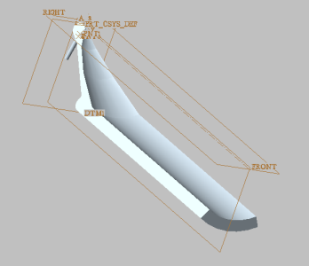

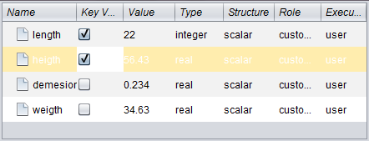


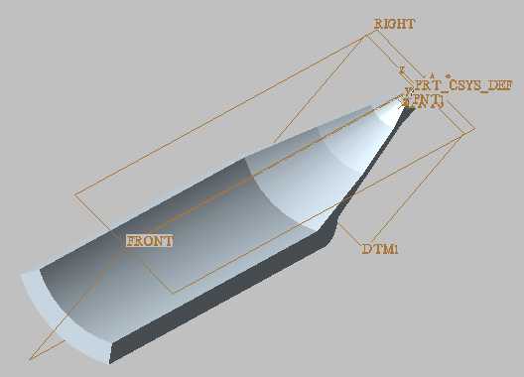
网络环境
查看模型并修改参数
服务器
返回可视化模型

